Slide 1
Java Script
// js

Slide 2
JavaScript
JavaScript is the most popular programming language which is used to create interactive webpages
JavaScript is the client-server side scripting language which is used to create dynamic web pages
JavaScript was invented by Brendan Eich in 1995, and became an ECMA standard in 1997.
ECMA-262 is the official name of the standard. ECMAScript is the official name of the language.
Current version of JS is ES6 (introduced after 2015)

Slide 3
Characteristics of JavaScript
Client-side scripting language : The code is readable analyzable and executable by browser itself
Interpreted Language : JavaScript is an interpreted language, meaning it is executed line by line at runtime.
Dynamically types Language : JavaScript is dynamically-typed, which means you don't need to specify the data type of a variable when declaring it. The type is determined at runtime.
Weakly Typed Language : Semicolon is not mandatory at all the time
Synchronous in nature : It will executes line by line , we can make it as asynchronous

Slide 4
Advantages of JS
Easy to learn and implement
Reduces server load
Efficient performance
Regular updates
Platform independent
It has more frameworks and libraries

Slide 5
Environmental Setup
We can run JavaScript code in two environments.
  Browser
  Node.js
Browser understand the js through JS engine and Every browser consists of JavaScript engine which helps to run JS code
Browser | JS engine
Chrome | V8
Mozilla Firefox | Spider monkey
Microsoft Edge | Chakra
Safari | JavaScript Core Webkit

Slide 6
How to include JS in HTML
We can insert JS code to HTML in two ways
  1.Internal JS
  2.External JS

Slide 7
Output Methods
Console.log(“hello”)
  It will print the output in console window
Document.write(“Hello”)
  It will print the output in user interface
Document.writeln(“Hello”)
  It will print the output in user interface

Slide 8
Tokens
Building blocks of every programming language
Keywords : Predefined words whose task is already predefined
Identifiers : The name given for the variables ,arrays , objects etc..
Literals : The values written by developer

Slide 9
Variables
In JavaScript We have 3 keywords to declare variables(var , let , const)
Syntax To declare variable:
var/let/const identifier;
var/let/const identifier=value;

Slide 10
Var , let and const
 | var | Let | Const
Declaration | yes | yes | Declaration with initialization
Initialization | Yes | Yes | No
Reinitialization | Yes | Yes | No
Redeclaration | Yes | No | No
Scope | Global scope | Script scope | Script scope
Hoisting | Yes | Yes(TDZ) | Yes(TDZ)

Slide 11
Hoisting
Hoisting is JavaScript's default behavior of moving all declarations to the top of the current scope (to the top of the current script or the current function).
In JavaScript, a variable can be declared after it has been used.
Example:
  console.log(myVar); // Outputs: undefined
  var myVar = 42;

Slide 12
The let and const Keywords
Variables defined with let and const are hoisted to the top of the block, but not initialized.
Meaning: The block of code is aware of the variable, but it cannot be used until it has been declared.
Using a let variable before it is declared will result in a ReferenceError.
The variable is in a "temporal dead zone" from the start of the block until it is declared:
A temporal dead zone (TDZ) is the area of a block where a variable is inaccessible until the moment the computer completely initializes it with a value.

Slide 13
Datatypes in JS
Datatype defines the type of data to be stored in a particular memory allocation
JavaScript has 7 Datatypes(primitive)
  1. String
  2. Number
  3. Bigint
  4. Boolean
  5. Undefined
  6. Null
  7. Symbol
Non primitive
  A function
  An object
  An array

Slide 14
Datatypes
String : We can declare the string in js in 3 ways
  Example : ‘hello’ ,”hello” ,`Hello everyone`
Number : Integer and floating point numbers
Boolean : True or false
Bigint : large amount of data
Undefined : It represents the value of an uninitialized values
Null : It is empty variable and for future use
Symbol : It will create function (mostly used in MongoDB)

Slide 15
Operators in JS
Predefined symbols used to perform particular task
Types of operators
Arithmetic Operators : +,-,*,/,%,++,--
Assignment Operators : +=,-=,*=,/=,%=,=
Comparison Operators : >,<, !=,>=,<=,==,===
Logical Operators : && , || , !
Ternary Operators : ( condition ) ? True stmt : false stmt

Slide 16
Conditional Statements
Conditional statements are used to perform different actions based on different conditions.
Use if to specify a block of code to be executed, if a specified condition is true
Use else to specify a block of code to be executed, if the same condition is false
Use else if to specify a new condition to test, if the first condition is false
Use switch to specify many alternative blocks of code to be executed

Slide 17
Loops in JS
Loops can execute a block of code a number of times
while loop : Repeats a statement or group of statements while a given condition is true. It tests the condition before executing the loop body
Do while loop : It is more like a while statement, except that it tests the condition at the end of the loop body.
For loop : Executes a sequence of statements multiple times and abbreviates the code that manages the loop variable

Slide 18
Functions In JS
A JavaScript function is a block of code designed to perform a particular task.
A JavaScript function is executed when "something" invokes it (calls it).
With functions you can reuse code
You can write code that can be used many times.
You can use the same code with different arguments, to produce different results.
Syntax :
  function myFunction(p1, p2) {
  return p1 * p2;
  }

Slide 19
JavaScript Function Syntax
A JavaScript function is defined with the function keyword, followed by a name, followed by parentheses ().
Function names can contain letters, digits, underscores, and dollar signs (same rules as variables).
The parentheses may include parameter names separated by commas:
(parameter1, parameter2, ...)
The code to be executed, by the function, is placed inside curly brackets: {}

Slide 20
Types of Functions in JS
Anonymous function
Named function
Function with expression
Nested function
Immediate invoking function
Arrow function
Higher order function
Callback function

Slide 21
1.Anonymous function
A function without name is known as Anonymous function
Syntax :
  function(parameters) {
  // function body
  }

Slide 22
2. Named Function
A function with name is called as named function
Syntax :
function functionName(parameters) {
  // function body
  }

Slide 23
3 . Function with expression
It is the way to execute the anonymous function
Passing whole anonymous function as a value to a variable is known as function with expression.
The function which is passed as a value is known as first class function
    EX : let x=function(){
    //block of code
    }
    x();

Slide 24
Nested function
A function which is declared inside another function is known as nested function.
Nested functions are unidirectional i.e., We can access parent function properties in child function but vice-versa is not possible.
The ability of js engine to search a variable in the outer scope when it is not available in the local scope is known as lexical scoping or scope chaining.
Whenever the child function needs a property from parent function the closure will be formed and it consists of only required data.
A closure is a feature of JavaScript that allows inner functions to access the outer scope of a function. Closure helps in binding a function to its outer boundary and is created automatically whenever a function is created.

Slide 25
Nested function
Function parent(){
let a=10;
function child(){
let b=20;
console.log(a+b);
}
Child();
}
Parent();

Slide 26
JavaScript currying
Calling a child function along with parent by using one more parenthesis is known as java script currying
Example:
  Function parent(){
  let a=10;
  function child(){
  let b=20;
  console.log(a+b);
  }
  return child;
  }
  parent()(); ==➔JavaScript currying

Slide 27
Immediate invoking function expression (IIFE)
A function which is called immediately as soon as the function declared is known as IIFE
We can invoke anonymous function by using IIFE
Example:
(function(){
console.log(“Hello”);
})();

Slide 28
Arrow function
It was introduced in ES6 version of JS.
The main purpose of using arrow function is to reduce the syntax.
If function has only one statement then block is optional.
It is mandatory to use block if function consists of multiple lines of code or if we use return keyword in function.
Example:
  Let x=(a,b)=>console.log(a+b);
  Let y=(a,b)=>{return a + b };

Slide 29
Higher order function(HOF)
A function which accepts a function as a arguement is known as HOF
It is used to perform multiple operations with different values.
Example:
  Function hof(a , b , task ){
  Let res=task(a,b);
  return res;
  };
  Let add=hof(10,20,function(x , y){
  return x + y;
  }
  Let mul = hof(10,20,function(x , y){
  return x*y;
  }
  Console.log(add());
  Console.log(mul());

Slide 30
Callback function
A function which is passed as an argument to another function is known as callback function.
The function is invoked in the outer function to complete an action
Example :
  function first(){
  Console.log(“first”);
  }
  function second(){
  Console.log(“third”);
  }
  function third(callback){
  Console.log(“second”);
  Callback()
  }
  first();
  third(second);

Slide 31
JAVASCRIPT ARRAYS
ARRAYS:- Array is collection of different elements.Array is heterogrnous in nature.
In javascript we can create array in 2 ways.
  By array literal
  2.By using an Array constructor (using new keyword)
1) JavaScript array literal:-
The syntax of creating array using array literal is: var arrayname=[value1,value2.....valueN];
As you can see, values are contained inside [ ] and separated by , (comma).
The .length property returns the length of an array.
Ex:-<script>
var emp=["Sonoo","Vimal","Ratan"]; for (i=0;i<emp.length;i++){ document.write(emp[i] + "<br/>");
}
</script>
Output Sonoo Vimal Ratan

Slide 32
2) JavaScript array constructor (new keyword):-
Here, you need to create instance of array by passing arguments in constructor so that we don't have to provide value explicitly.
Ex:-
<script>
var emp=new Array("Jai","Vijay","Smith");
for (i=0;i<emp.length;i++){ document.write(emp[i] + "<br>");
}
</script>
Output:- Jai
Vijay Smith

Slide 33
Java script Array methods
push() : It will insert an element of an array at the end
unshift() : It will insert an element of an array at the first
pop() : It will remove elements of array from the end
shift() : It will remove elements of array from the start
indexOf() :It will return a index of particular element
Includes() : It will check whether the particular element is present in array or not.
At() : It will return the element which is present in particular index.
Slice() : It will give slice of an array and it will not affect the original array.
Splice() : It is used to add or remove elements from an array

Slide 34
Java script Array methods
Join() : It is used to join all elements of an array into a string.
Concat() : It is used to join/concat two or more arrays.
toString() : It converts all the elements in an array into a single string and returns that string.
Split() : It is used to split a string into an array.
Reverse() : It is used to reverse an array.
Array.from() : It will convert string into an array

Slide 35
Filter() , map() , reduce()
Filter() :
filter() is a HOF which will check a particular condition for each element in the original array. If the element satisfy the condition the element will be pushed to the new array.
Syntax :
arr.filter((ele,index,arr)=>{
return condition
})
Example :
let numbers = [1, 2, 3, 4, 5];
let evenNo = numbers.filter((x) => x % 2 === 0);
console.log(evenNo); //[2, 4]
callback: This is the function that is used to test each element in the array. It takes three arguments:
  element: The current element being processed in the array.
  index (optional): The index of the current element being processed.
  array (optional): The array filter was called upon.

Slide 36
Filter() , map() , reduce()
Map() :
The map() method in JavaScript is used to create a new array by applying a function to every element in an existing array. It does not modify the original array. Instead, it returns a new array with the modified elements.
EX:
const numbers = [1, 2, 3, 4, 5];
const doubledNumbers = numbers. Map(number => number * 2);
console.log(doubledNumbers); // Output: [2, 4, 6, 8, 10]

Slide 37
Filter() , map() , reduce()
Reduce() :
the reduce() is a HOF which will return a single value from the original array. if no initial value is given, the accumulator will be assigned with the first value of the array
SYNTAX:-
arr.reduce((acc,ele,index,arr)=>{
//statements
},init)
Example: -
let arr = [1, 2, 3, 4, 5];
let sum = arr.reduce(( accumulator,currentValue,index,arr) => {
console.log( accumulator, currentValue,index);
return accumulator+currentValue
},100);
console.log(sum);//115

Slide 38
Objects in JS
Object is nothing but the thing which has existence in the world.
A JavaScript object is an entity having state and behavior (properties and method). For example: car, pen, bike, chair, glass, keyboard, monitor etc.
In java script object is used to store the data in key value pairs.
JavaScript is an object-based language. Everything is an object in JavaScript.
Objects are mutable.
We can access , update, add and delete the properties from an object.

Slide 39
OBJECTS IN JAVASCRIPT
A JavaScript object is an entity having state and behavior (properties and method). For example: car, pen, bike, chair, glass, keyboard, monitor etc.
JavaScript is an object-based language. Everything is an object in JavaScript.
Creating Objects in JavaScript:
There are 3 ways to create objects. 1.By object literal.
2.By creating instance of Object directly (using new keyword).

Slide 40
1)JavaScript Object by object literal:
The syntax of creating object using object literal is given below:
VariableName object=
{
property1:value1,
property2:value2,
propertyN:valueN
}
As you can see, property and value is separated by : (colon).
Example of creating object in JavaScript.
<script>
Let emp={
id:102,
name:"Kumar", salary:40000
}
document.write(emp.id+" "+emp.name+" "+emp.salary);
</script>

Slide 41
2) By creating instance of Object:
The syntax of creating object directly is given below:
var objectname=new Object();
Here, new keyword is used to create object.
Example of creating object directly.
<script>
var emp=new Object(); emp.id=101; emp.name="Ravi"; emp.salary=50000;
document.write(emp.id+" "+emp.name+" "+emp.salary);
</script>

Slide 42
In JavaScript, to access and manipulate object properties: dot notation
Dot notation
Dot notation is the most common way to access object properties. It uses a period (.) to access the value of a property by its key.
Here’s an example:
const
person = { name: 'John', age: 30, address: {
street: '123 Main St',
city: 'New York'
}
};
console.log(person.name); // John console.log(person.address.city); // New York

Slide 43
OBJECT METHODS
Objects can also have methods.
Methods are actions that can be performed on objects.
OBJECT METHODS:
1.keys : It will return array of keys
2.Values : It will return array of values
3.Entries : It will return array of keys and values
4.Assign : It is used to merge two objects
5.Seal : We can only update the properties
6.isSealed : It is used to check whether the particular object is sealed or not
7.Freeze : We cannot do any modifications in an object
8.Isfrozen : It is used to check whether the particular object is frozen or not

Slide 44
let obj4={
ename:"lavanya",
id:123,
sal:20000
};
let obj5={
ename1:"bujji", id1:12, sal1:40000
};
console.log(Object.keys(obj4));//array of keys console.log(Object.values(obj4))//array of values console.log(Object.entries(obj4))//array of keys and values console.log(Object.assign({},obj4,obj5))//merge multiple objects console.log(obj4)//stroring all properites of obj5 into obj4 Object.seal(obj4);//In seal method i can update can’t add,i cant remove,can
fetch
console.log(Object.isSealed(obj4));//true

Slide 45
delete obj4.ename; console.log(obj4)
obj4.sal=12000; console.log(obj4); console.log(obj4.sal);
Object.freeze(obj4); console.log(Object.isFrozen(obj4))//true obj4.skills="html";
obj4.sal=300; console.log(obj4)
console.log(obj4)//freeze object we cant add,we cant update,we cant delete,we can fetch
delete obj4.id
console.log(obj4);

Slide 46
LOOPS IN JAVASCRIPT
Loops can execute a block of code a number of times.
  forEach - loops through a block of code a number of times
  for/in - loops through the properties of an object
  for/of - loops through the values of an iterable object
forEach():-
The forEach() method calls a function for each element in an array.
The forEach() method is not executed for empty elements.
Example:
const array1 = ['a', 'b', 'c’];
array1.forEach((element) => console.log(element));

Slide 47
Output:- 1
2
3
4
5
For of loop:-
Iterable objects are objects that can be iterated over with for..of. <script> Ex:-const name = "W3Schools";
let text = ""
for (const x of name){ text += x + "<br>";
}

Slide 48
The JavaScript for in loop iterates over the keys of an object
Ex:-
For in loop:-
const object = { a: 1, b: 2, c: 3 }; for (const property in object) {
console.log(`${property}: ${object[property]}`);
}
// Expected output:
// "a: 1“
// "b: 2“
// "c: 3“

Slide 49
STRING:-Collection of characters (or) bunch of characters we called it as string
STRING CONCEPT IN JAVASCRIPT
String methods:-
String length String slice() String substring() String substr() String replace() String replaceAll()
String toUpperCase() String toLowerCase() String concat()
String trim() String trimStart() String trimEnd() String padStart() String padEnd() String charAt()
String charCodeAt() String split()

Slide 50
The length property returns the length of a string:
Ex:-
let text = "ABCDEFGHIJKLMNOPQRSTUVWXYZ";
Console.log(text.length)//26
slice() extracts a part of a string and returns the extracted part in a new string. The method takes 2 parameters: start position, and end position (end not included). Ex:-
let text = "Apple, Banana, Kiwi"; let part = text.slice(7,13);//banana
substring( ):- it is similar to slice( ) Syntax:-substring(start,end)
The difference is that substring( ) cannot accept negative indexes. Ex:-
let text = "Apple, Banana, Kiwi";
let part = text.substring(7,13);//banana

Slide 51
4.substr( ):-
Substr( ) is similar to slice( )
The difference is that the second parameter specifies the length of the extracted part.
Ex:-
let text = "Apple, Banana, Kiwi";
let part = text.substr(7,6);//banana
replace( ):-The replace method replaces a specified value with another value in a string By default,the replace( ) method replaces only the first match.
Ex:-
let text = "Please visit Microsoft!";
let newText = text.replace("Microsoft", “js");//”please visit js
trim( ):-
The trim( ) method removes whitespace from both sides of a string. Ex:-
let text1 = " Hello World! ";
let text2 = text1.trim();//hello world!

Slide 52
7.indexOf( ):-
The indexOf( ) method returns the index of the position of the first occurrence of a specified text in a string.
indexOf( ) return -1 if the text is not found. Ex:-
Let str=“please locate where ‘locate’ occurs!”; str.indexOf(“locate”);//7 Str.indexOf(“locate”);//-1
lastIndexOf( ):-
The lastIndexOf() method of String values searches this string and returns the index of the last occurrence of the specified substring. It takes an optional starting position and returns the last occurrence of the specified substring at an index less than or equal to the specified number.
Ex:-
Let str=“please locate where ‘locate’ occurs!”; str.indexOf(“locate”);//21 Str.indexOf(“locate”);//-1

Slide 53
9.Includes( ):-
The includes() method returns true if a string contains a specified string.
Otherwise it returns false.
The includes() method is case sensitive.
Syntax:-string.includes(searchvalue, start)
Ex:-
let text = "Hello world, welcome to the universe.";
let result = text.includes("world");//true
repeat( ):-
The repeat() method returns a string with a number of copies of a string. The repeat() method returns a new string.
The repeat() method does not change the original string

Slide 54
let text = "Hi";
let result = text.repeat(2);//hi hi
charAt( ):-
it will return the character of the specified position
Ex:-
var str=“hi guys”
Console.log(str.charAt(3));//g
charCodeAt( ):-
It will return the ASCII value of specified index value of that character. Ex:-
Ex:-var str=“javascript” Console.log(str.charCodeAt(1));//97 Split( ):-covert string to array.
Join( ):-convert array to string

Slide 55
BOM and DOM
BROWSER OBJECT MODEL AND DOCUMENT OBJECT MODEL

Slide 56
BOM(Browser Object Model)
The Browser Object Model (BOM) allows JavaScript to "talk to" the browser.
"BOM" stands for Browser Object Model. It represents the objects that a browser provides to JavaScript to interact with the browser itself.

Slide 57
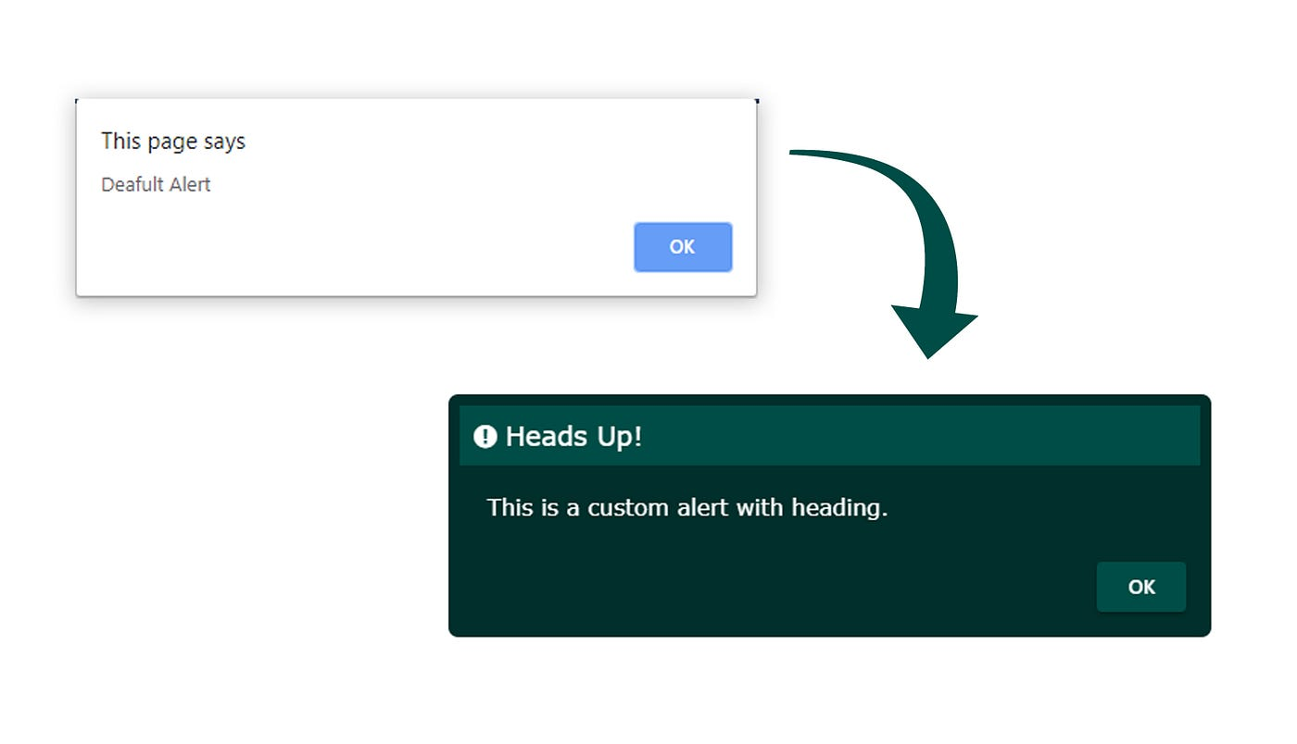
JavaScript Popup Boxes
JavaScript has three kind of popup boxes: Alert box, Confirm box, and Prompt box.
Alert Box
An alert box is often used if you want to make sure information comes through to the user.
When an alert box pops up, the user will have to click "OK" to proceed.

Slide 58
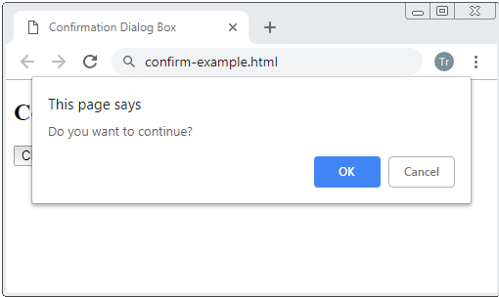
JavaScript Popup Boxes
Confirm Box
A confirm box is often used if you want the user to verify or accept something.
When a confirm box pops up, the user will have to click either "OK" or "Cancel" to proceed.
If the user clicks "OK", the box returns true. If the user clicks "Cancel", the box returns false.

Slide 59
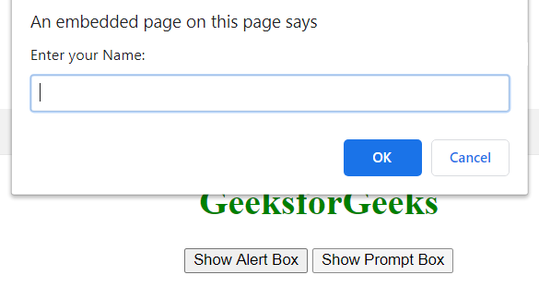
JavaScript Popup Boxes
Prompt Box :
A prompt box is often used if you want the user to input a value before entering a page.
When a prompt box pops up, the user will have to click either "OK" or "Cancel" to proceed after entering an input value.
If the user clicks "OK" the box returns the input value. If the user clicks "Cancel" the box returns null.

Slide 60

DOM(Document Object Model)
In JavaScript, the DOM (Document Object Model) is a programming interface for web documents. It represents the structure of a document as a tree-like model where each node is an object representing a part of the document, such as elements, attributes, and text.
When a web page is loaded, the browser creates a Document Object Model of the page.
The HTML DOM model is constructed as a tree of Objects:

Slide 61
DOM Methods
Methods used to target HTML elements in JavaScript file
getElementById(id): This method allows you to retrieve an element from the document by its unique id.
getElementsByClassName(className): This method returns a collection of all elements in the document with a specified class name.
getElementsByTagName(tagName): Returns a collection of elements with the specified tag name.
querySelector(selector): Returns the first element that matches a specified CSS selector.
querySelectorAll(selector): Returns a NodeList of all elements that match a specified CSS selector.

Slide 62
DOM Events
Event: An action performed by the user on the webpage is known as an event
A JavaScript can be executed when an event occurs, like when a user clicks on an HTML element.
  Click
  Mouseover
  Mouseout
  Mousedown
  Mouseup
  Doubleclick
  Keypress
  Keyup
  Keydown

Slide 63
DOM Event Listener
The addEventListener() method attaches an event handler to the specified element
The first parameter is the type of the event (like "click" or "mousedown" or any other HTML DOM Event.)
The second parameter is the function we want to call when the event occurs.
Ex:
  element.addEventListener("click", function(){
  alert("Hello World!");
  });

Slide 64
Event Propagation
Event propagation refers to the way events travel through the DOM tree. When an event occurs on an element, it can trigger event handlers not only on that element but also on its parent elements, all the way up to the root of the document. There are two phases of event propagation:
Capturing Phase: The event travels from the root of the DOM tree down to the target element.
Bubbling Phase: The event then bubbles up from the target element back to the root.
event.stopPropagation(): This method prevents further propagation of the current event. It stops the event from bubbling up the DOM tree or from capturing down the tree
stopPropagation() in bubbling phase, it will block the progation to reach to the outer moat element from the targetted element
stopPropagation() in capturing phase, it will block the progation to reach to the targetted element

Slide 65
JSON(Java Script Object Notation)
It is format of storing and transporting data.
It is used when the data is sent form the server to web page
It is a popular data format for developers because of its human readable text, light weight which requires less coding and faster process
Example: [
{“fname”:”Ram”,”lname”:”Patil”},
{“fname”:”Raj”,”lname”:”smith”},
{“fname”:”Ashish”,”lname”:”gouda”}
]

Slide 66
Syntax of JSON
Data is in Key value pairs
Data is separated by ‘,’
Curly braces holds objects
[ ]---holds array
In JavaScript, there are two main methods used to work with JSON (JavaScript Object Notation):
1.JSON.Stringify() : used to convert normal object to JSON format
2.JSON.parse(): Used to convert JSON format of data to normal object

Slide 67
Time delays
setTimeOut() and setInterval() are two functions in js allows to schedule tasks to be executed at later time. Used for animations, polling data from server and other asynchronous tasks.
setTimeOut() :
Runs the code with time delay
Syntax : window.setTimeOut( function , delay ) ;
function: The function you want to execute.
delay: The amount of time (in milliseconds) before the function is executed

Slide 68
Time delays
setInterval() :
The function similar to setTimeOut, but it schedules a function to be executed repeatedly at specified interval.
Syntax : window.setInterval( function , delay ) ;
function: The function you want to execute.
delay: The amount of time (in milliseconds) before the function is executed
createTimeOut() and createInterval()
cancel a setTimeout, you use clearTimeout
cancel a setTimeout, you use clearTimeout

Slide 69
Promises
In JavaScript, promises are a mechanism for handling asynchronous operations. They provide a way to work with asynchronous code in a more structured and readable manner. Promises represent a value that may not be available yet but will be resolved at some point in the future, either successfully with a result or with an error.
A promise represents the eventual result of an asynchronous operation. It can be in one of three states:
Pending: Initial state, neither fulfilled nor rejected.
Fulfilled: Meaning the operation completed successfully.
Rejected: Meaning the operation failed.

Slide 70
Syntax to create promise
const myPromise = new Promise((resolve, reject) => {
// Asynchronous operation, e.g., fetching data from a server.
if (/* operation successful */) {
resolve('Success data'); // Resolve if successful.
} else {
reject('Error message'); // Reject if there's an error.
}
});

Slide 71
Consuming a Promise:
Then() : It will executed when the promise will be in resolved state
Catch() : It will get executed when the promise is in rejected state
Finally() : It will execute always means promise is in resolve , reject or in pending state

Slide 72
Promise methods
1) Promise.all() ==> all promise should be in resolve state
2) Promise.allSettled() ==> either resolve/ reject, then() block will execute or else catch() block..[catch block output we cant see]
3) Promise.any() ==> atleast 1 or more promises should be resolved, then() will execute or else catch() block.
4) Promise.race() ==> it depends upon time, which ever comes first that promise will get executed.

Slide 73
Fetch API
* fetch() is used to send a request to backend, it accepts a URL/API as an argument. This url should be in String
* The fetch method returns a promise object, This object need to be handled using then() and catch()
* We need to first handle the response object and parse it to get normal object using json()
* In the next then method we will be able to consume the data (using data from backed is called consuming data)
EXAMPLE:-
fetch("https://api.github.com/users")
.then((response) => response.json())
.then((data) => {
console.log(data[0].login);
})
.catch((error) => {
console.log(error);
});

Slide 74
Async and await
"async and await make promises easier to write"
async makes a function return a Promise
await makes a function wait for a Promise
Async : The async keyword is used to define a function that returns a promise. It allows you to write
Await : The await keyword is used inside an async function to wait for a Promise to settle (either resolve or reject). It can only be used inside an async function

Slide 75
EXAMPLE:-
let tbody = document.getElementById("tbody");
let fetchData = async function () {
let response = await fetch("https://api.github.com/users");
let data = await response.json();
displayData(data);
};
fetchData();
let str = "";
function displayData(apiData) {
apiData.forEach((ele) => {
str += `
<tr>
<td>${ele.login}</td>
<td>${ele.id}</td>
<td><a href='${ele.url}' class = 'link'>link</a></td>
<td><img src='${ele.avatar_url}'></td>
</tr>
`;
tbody.innerHTML = str;
});
}

